Slide 1

Contactless Fare Payment Pre-Implementation Survey
Agency Meeting
January 9, 2022

Slide 2
Approach to Analysis
Observed travel behavior (ridership) before and after implementation
NTD ridership numbers reported monthly
Surveyed frequency of transit use
Attitudes about transit, COVID safety, fare payment, trip planning
Pre-implementation survey about current attitudes and fare payment capabilities
Questions focused on bankedness, smartphone access, and fare payment preferences
Questions focused on COVID-related safety concerns
Questions focused on transit quality of service, including ease of planning a trip
Post-implementation survey about change in attitudes/satisfaction with contactless fare payment and trip planning app
Operational benefits and drawbacks of the fare payment & trip planning application
Revenue and operating costs reported monthly
Transit operator interviews for qualitative feedback
Boarding efficiency, safe customer/driver interactions

Slide 3
Project Timeline
Develop Plan
Survey 1
User Base Matures
Survey 2
Survey Analysis
Interviews
January
February
March
April
May
June
July
August
September
Tentative Schedule* | Tentative Schedule
January 9 | Meeting with partner agencies
January 23 | Agency Capability Form Due
January 23-27 | Finalize Survey Distribution Plan (Office of Measurement)
February 1 - 28 | Distribute Pre-Deployment Survey to Passengers
March ~ | Transit App Deployed, User Base Matures
May/June | Distribute Post-Deployment Survey (Through Transit App, Contacting Respondents from Survey 1)
September | Interview with Transit Agencies on Operational Benefits/Drawbacks
*subject to change

Slide 4
Rider Survey Goals
Targeting existing riders of 6 partner transit agencies
2-5 minutes long, completed online, on paper aboard transit vehicles, or over the phone when booking
Post-implementation survey distributed through text/email to previous survey participants and recruited from Transit app users
800+ respondents, representative of the project area:
Geographic distribution of riders by agency

Slide 5








Survey Distribution Methods – Passive v. Active
Passive
Active
Emailing a link to existing riders with emails on file
Texting existing riders with phone numbers on file
Posting a QR code inside vehicles
Posting a link/QR code on agency websites/social media
Supplying paper/tablet surveys inside vehicles for riders to complete during their trip
Asking each rider a short (2-3 minutes) set of survey questions when they call to book a ride
Equipping agency staff with a clipboard/tablet and sending them on vehicles to interview passengers during their trip
Partnering with community organizations/attending community events

Slide 6
Rider Survey Participation Incentive
One free ride from the agency
Voucher sent to passenger for next trip (mailed, emailed, texted, etc)
Our team would develop a tool for verifying each passenger only fills out the survey/receives the incentive once
Otherwise, will likely enter participants for a drawing of a gift card
Participants would have to provide email address/phone number for entry

Slide 7
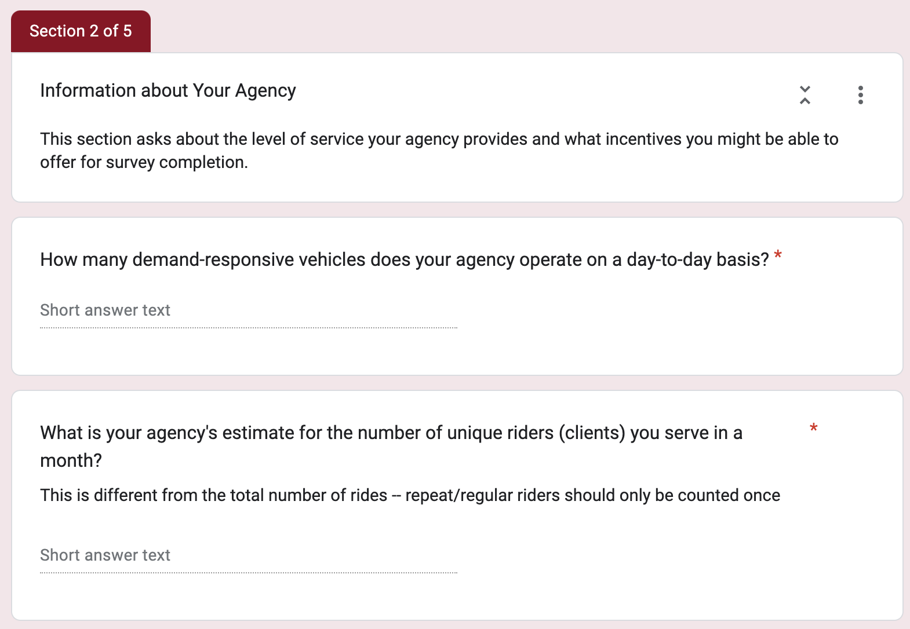
Action Items
Any immediate feedback about survey distribution methods or incentives?
Complete Google form before January 23

